Slide 1
How thrust system should work
AT THE MOMENT

Slide 2
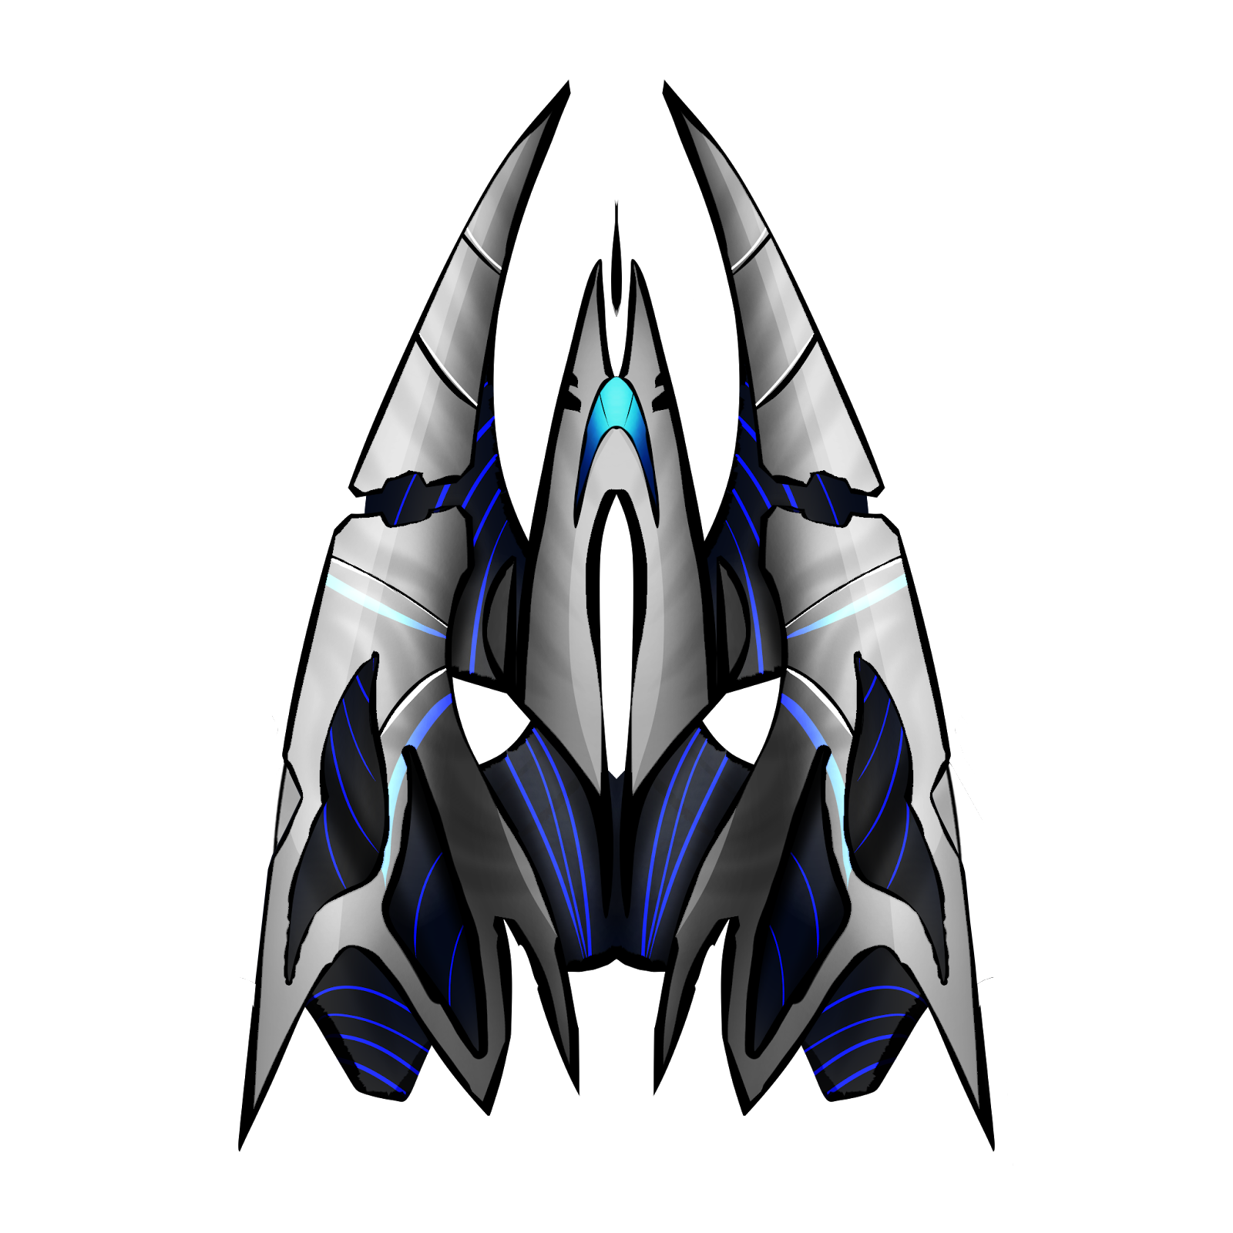
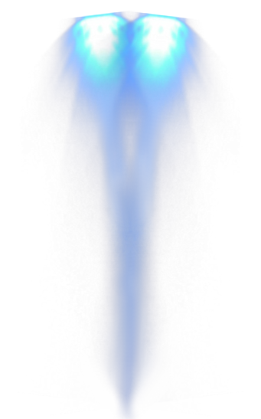
SHIP HAS THE ENGINE
IT CAN BE SWITCHED ON
OR SWITCHED OFF

Slide 3
SAME ABOUT THE CODE
if (key is pressed)
{
torque = 100;
}
else
{
torque = 0;
}

Slide 4
WHY NOT CONSTANT SPEED
Indeed, force option makes the speed unlimited.
However, player will need to achieve great velocities when travelling.

Slide 5
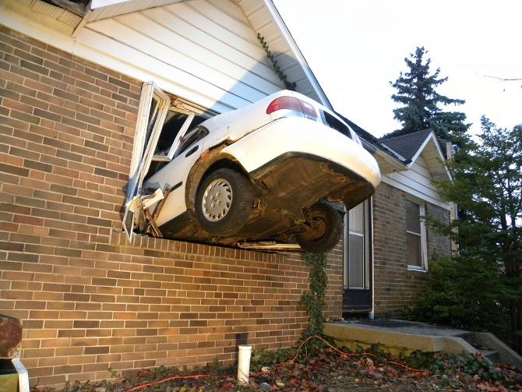
WHY NOT CONSTANT SPEED
Higher the speed –
more difficult
to handle vessel.

Slide 6
THAT’S ALL FOR NOW.
Am gonna find some cool png:s for planets and so.

